Slide 1
1.2 Text, sound and images
Representing sound

Slide 2
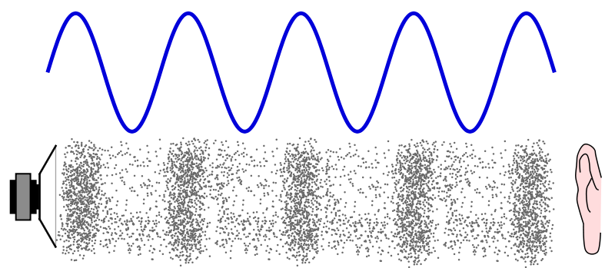
What is sound?

Slide 3


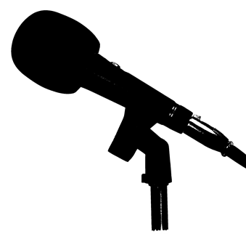

How sound is sampled and stored in digital form
Analog
signal
Digital
signal
100100100100101001010011001
ADC

Slide 4
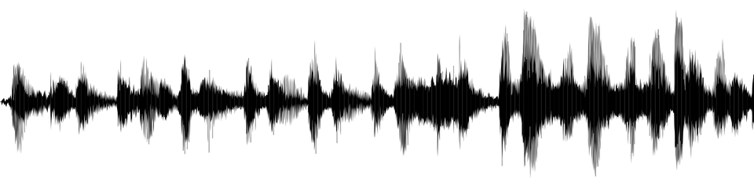
Sound wave
What affects the quality of a digitally converted sound wave?
Sample rate
(speed)
+
Sample resolution
(detail)

Slide 5
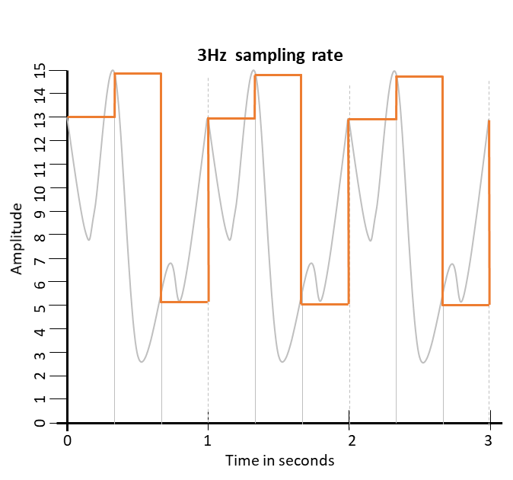
Sample rate and bit depth
Sample rate: How often (frequency) the amplitude of a sound wave is recorded. The more often a sample is recorded, the smoother the playback will sound.
3Hz sample rate
The number of samples per second, measured in hertz (Hz).
A typical audio file is recorded at 44,100Hz – i.e., 44,100 samples per second.
Notes:
-

Slide 6
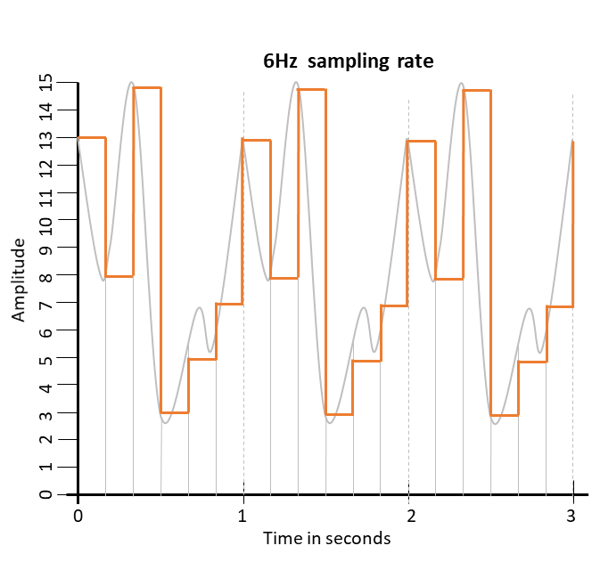
Sample rate and bit depth
Sample rate: How often (frequency) the amplitude of a sound wave is recorded. The more often a sample is recorded, the smoother the playback will sound.
3Hz sample rate
6Hz sample rate
The number of samples per second, measured in hertz (Hz).
A typical audio file is recorded at 44,100Hz – i.e., 44,100 samples per second.
Notes:
-

Slide 7
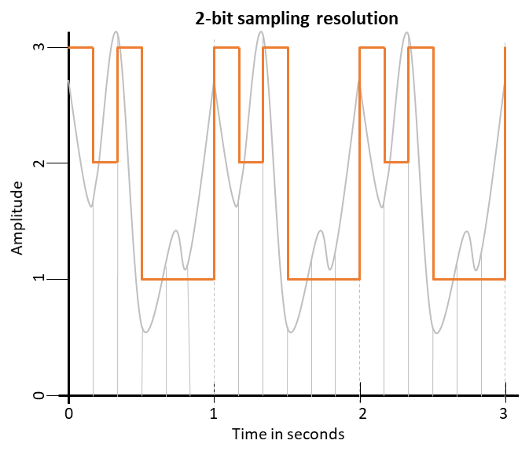
Sample rate and bit depth
Sample resolution: How many different gradations of amplitude can be represented in a digital waveform.
The amount of information stored with each sample, measured in bits.
Typically, CDs are 16-bit, meaning each sample takes up 2 bytes and can store one of 65,536 amplitudes.
Notes:
-

Slide 8
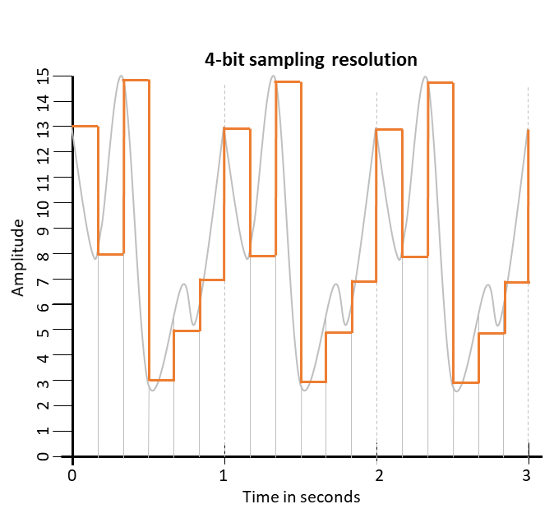
Sample rate and bit depth
Sample resolution: How many different gradations of amplitude can be represented in a digital waveform.
The amount of information stored with each sample, measured in bits.
Typically, CDs are 16-bit, meaning each sample takes up 2 bytes and can store one of 65,536 amplitudes.
Notes:
-

Slide 9
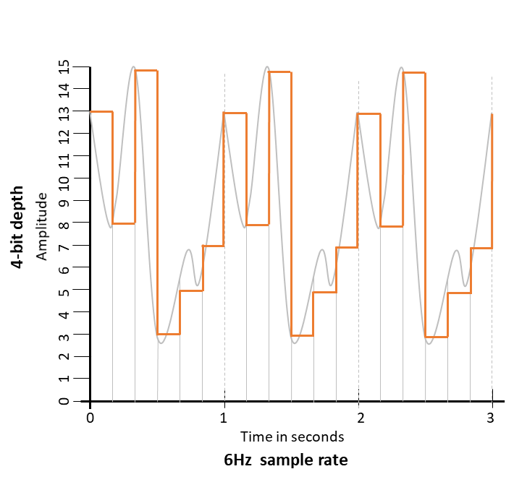
Calculating sound sample sizes
Sound file size = (Number of samples per second) x (Number of bits per sample) x (Length of sample in seconds)
Size of a sound file
Sample rate |  | Number of samples per second
Duration |  | Length of sample in seconds
Sample resolution |  | Number of bits needed to store each sample
4-bit sample resolution
Notes:
-

Slide 10
Calculating sound sample sizes
Sound file size = (Number of samples per second) x (Number of bits per sample) x (Length of sample in seconds)
Size of a sound file
Sample rate | 6 | Number of samples per second
Duration | 3 | Length of sample in seconds
Sample resolution | 4 | Number of bits needed to store each sample
6 x 3 x 4 | = | 72 bits = 9 bytes
4-bit sample resolution
Notes:
-

Slide 11

Representing sound
Sound file size: The total number of bits in a sound file. Calculated as: (Number of samples per second) x (Number of bits per sample) x (Length of sample in seconds).
Sample resolution: The number of bits stored per sample. The higher the sample resolution, the greater the quality of the sound and the larger the file size.
Sample rate: The number of samples stored per second. The higher the sample rate, the higher the quality of the sound, and the larger the file size.

Slide 12


